Slide 1



Automated test

Slide 2
Car diagnose computer

Slide 3
Car diagnose computer
Car has to be build to be tested
Each test will tell of a potential error
Only errors that matters will be reported
If all tests succeed, it is safe to drive the car

Slide 4
Class diagnosis
ClassCar has to be build to be tested
Each test will tell of a potential error
Only errors that matters will be reported
If all tests succeed, commit drive the Class car
Which aspects of the CarClass should we test?
How to make it easy to test a CarClass
How to automate the test
To make it easy to test after you have made changes

Slide 5
Test concepts – expected behaviour
To test a method, we need to specify what are the expected behaviour
Behaviour:
Return value
Thrown exceptions
Calls to other objects
Changes to the object of the method
Changes to external components (for example database)

Slide 6
Three levels of tests
Unit tests
At the level of individual methods and classes
Tool: JUnit
Integration tests
Across layers
Tool: Mock objects
System tests
The whole system
Tool: Mock, Performance

Slide 7
Specialized tests
User interface tests
Does the user inteface work correctly?
Tools: Specialized automated input control
Acceptance tests
A contract between the developers and the product owner on when a user story is implemented
Tools: Sometimes automates, sometimes not
User testing
Letting future users of the system try to use a preliminary version of the system to see if they can use the program to solve their tasks.

Slide 8
Testing in the polygon project
Unit tests
Must have some
Integration tests
Should have one
System tests
User interface tests
Acceptance tests
Cool if you do
User testing

Slide 10
White-box & black-box testing
White-box testing focuses on the text of the program.
The tester constructs a test suite that demonstrates that all branches of the program can be executed.
The test suite is said to cover the statements of the program.
Black-box testing focuses on the problem that the program is supposed to solve
More precisely, the problem statement or specification for the program.

Slide 11
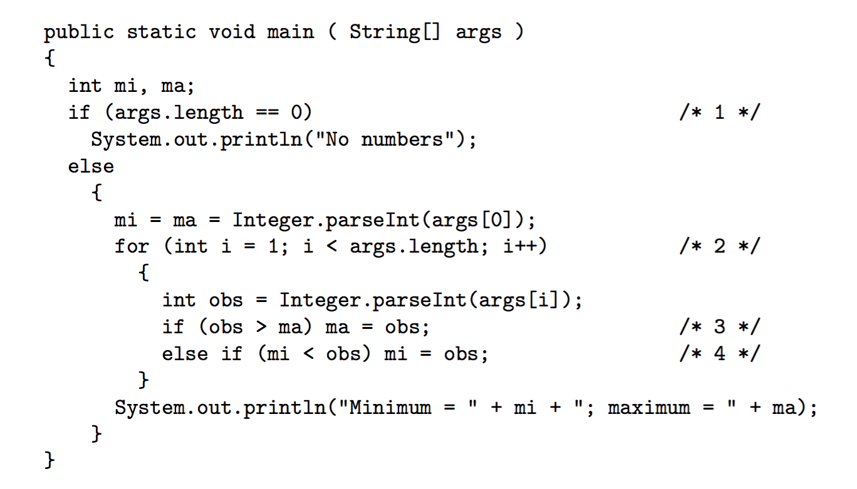
Example 2.1

Slide 12
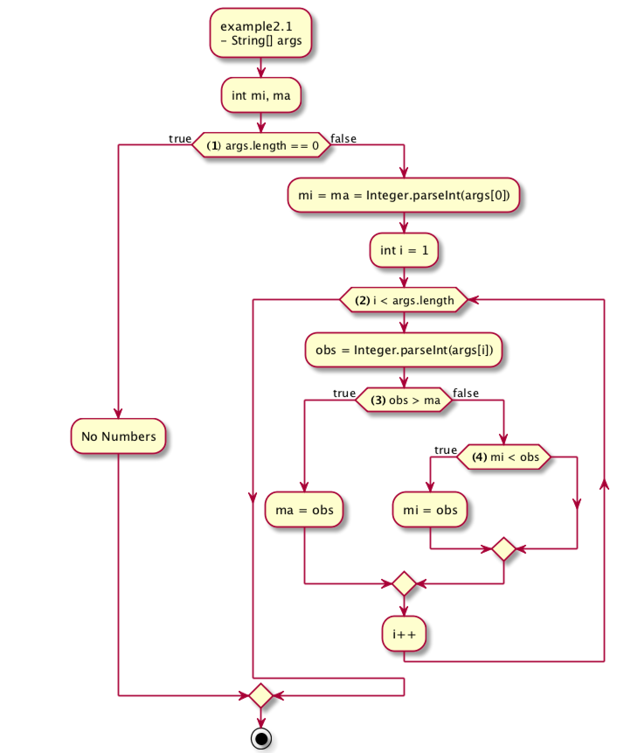
Example 2.1

Slide 13
Constructing test input
The resulting test suite includes enough input data sets to make sure that:
all methods have been called,
that both the true and false branches have been executed in if statements,
that every loop has been executed zero, one, and more times – why is “more times” important?
that all branches of every switch statement have been executed.
For every input data set, the expected output must be specified also.
Notes:
The “more times” is important because there is a risk that we have not established the invariant inside the loop, and therefore that the loop will not run correctly the next time around.
Or, explained without invariants. If we only check zero and one time, we only check if the program can continue correctly after the loop, not if we can enter the loop correctly again.

Slide 14
Test coverage
In practice white box testing is done on
Algorithms
To analyze for security holes
Normally one use automated test coverage tools:
Measures to which extend our code has been tested
Integrated into Netbeans – colors your code red, green, yellow
It is pragmatic and “good enough”.

